Slide 1
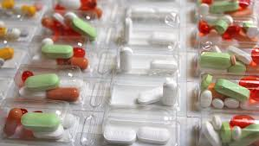
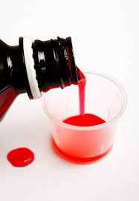
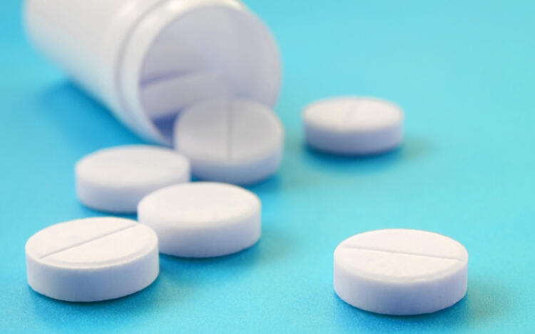
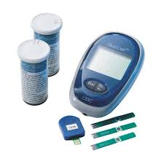
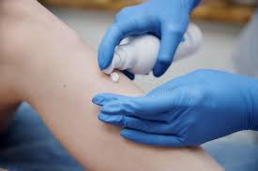
Medication Awareness Avenue II

Slide 2
Agenda
Why and how do people take medication?
PRN medication
Video
Support worker responsibilities
Medical appointments
Avenue II’s medication philosophy
Supporting with medication

Slide 3
Why do people take medication?
Medical conditions, for example:
Epilepsy
Infections
Depression or other mental illness
Asthma
Skin irritations or conditions
Pink Eye
Yeast Infection
Birth Control
Vitamin Deficiency
We support individuals to take medication prescribed by a doctor for medical conditions and/or therapeutic reasons. *Examples of therapeutic reasons being birth control, vitamins, CBD oil, etc.

Slide 4
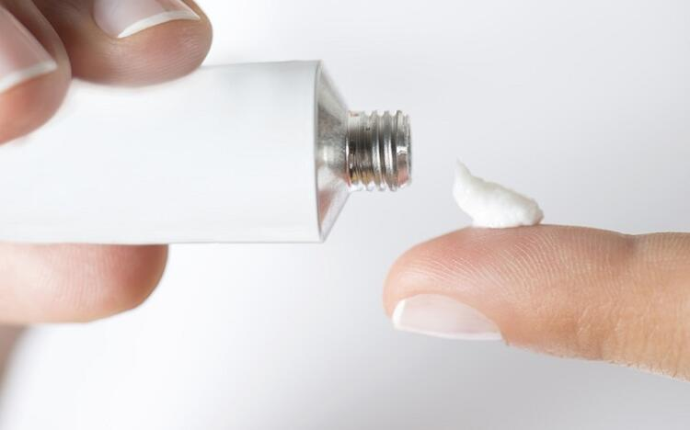
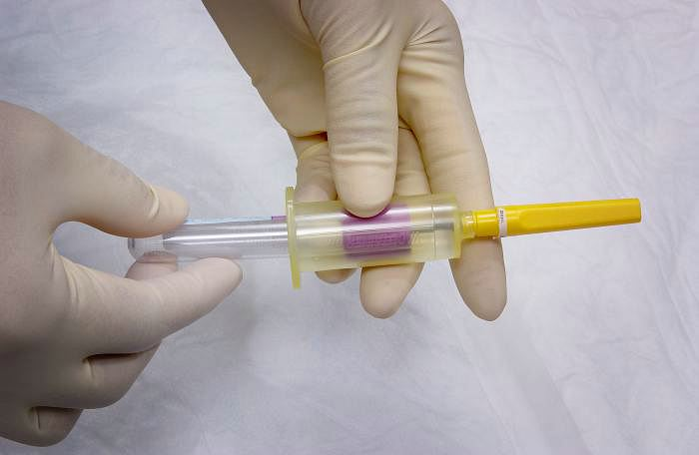
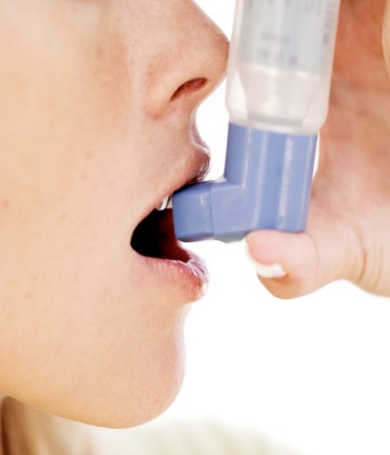
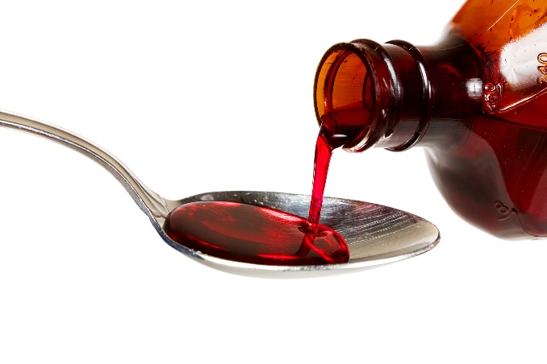
How do people take medication?
Orally – by mouth
Topical – on skin
Inhalation
Injections

Slide 5
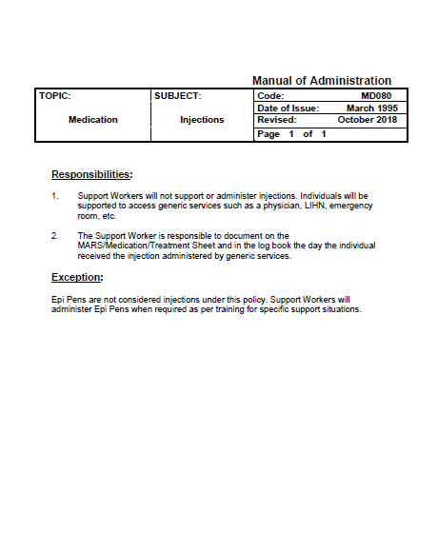

Slide 6
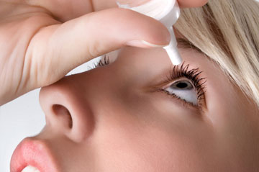
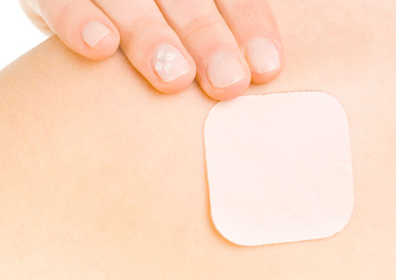
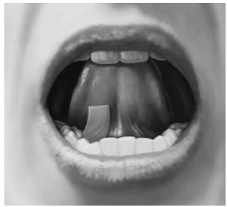
How do people take medication?
Orally – by mouth
Topical – on skin
Inhalation
Injections
Vaginally/rectally
Sublingual – absorbed under tongue
Buccal – pocket of cheek
Dermal Patches
Eye or ear drops

Slide 7
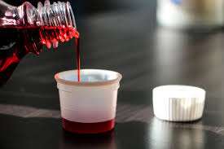
Non-Prescription Medications (also known as “over the counter” or “OTC” medications)

Slide 9
What does PRN mean?
Pro Re Nata
Latin – as needed or as the situation arises.
Common need for PRN’s
Rashes
Dandruff
Anxiety /Appointments
Headaches
Coughs
Allergic Reactions/Epi-Pen
Asthma/Inhaler
Upset Stomach/Tums
Notes:
It is generally used as the acronym PRN in medicine to refer to dosage of prescribed medication that is not scheduled.

Slide 10
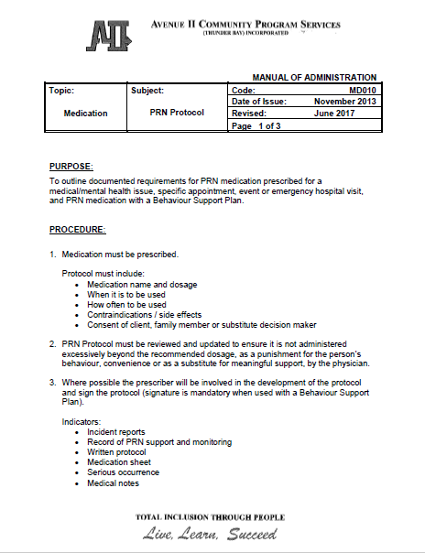

Slide 11
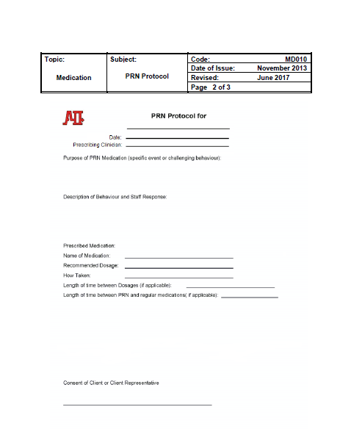

Slide 13
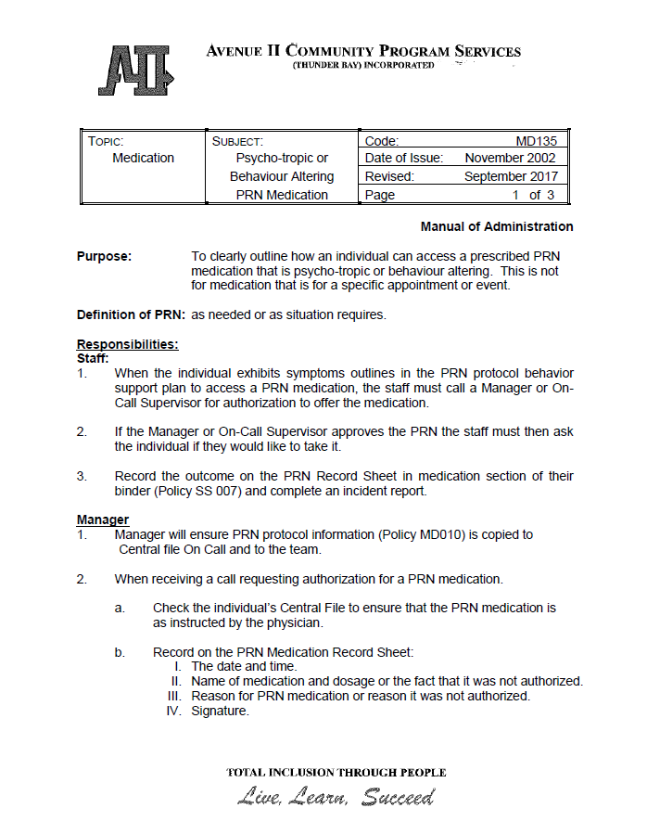

Slide 14
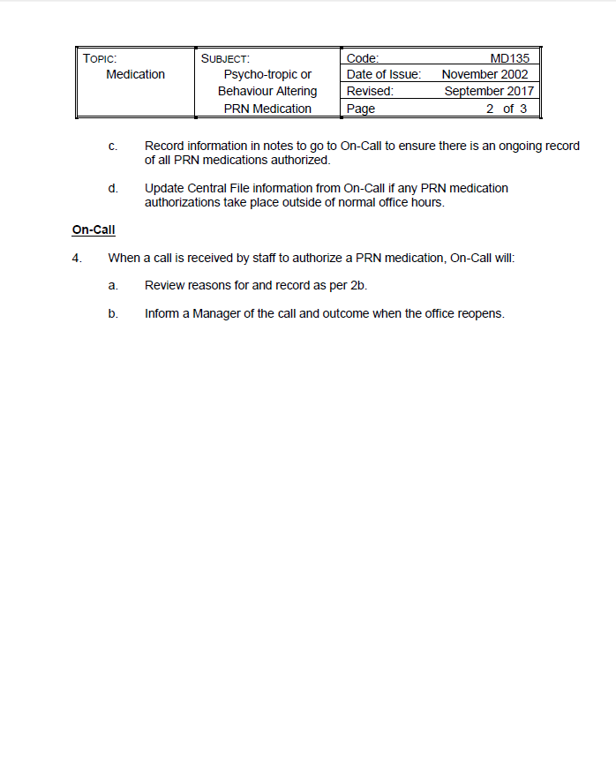

Slide 15
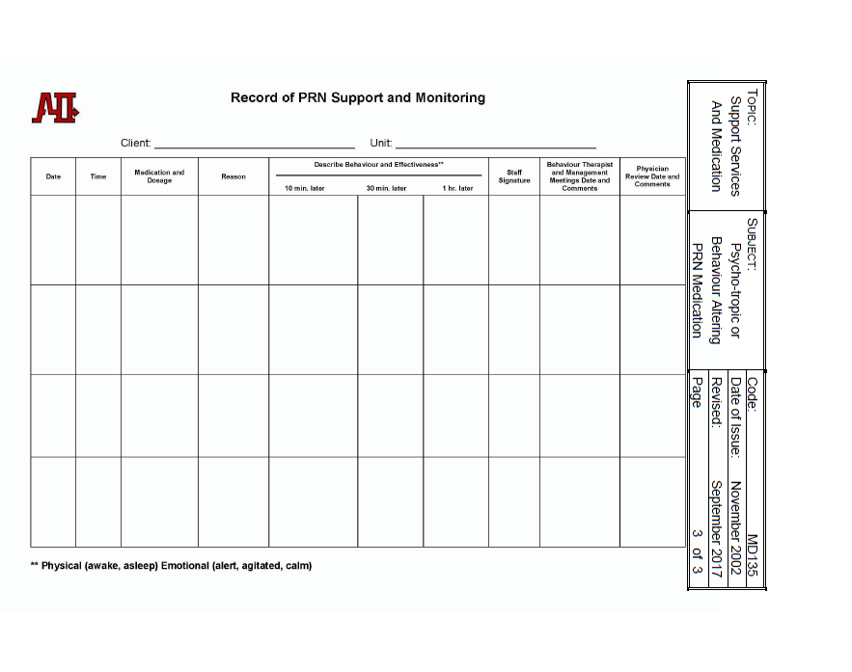

Slide 16
Videos
Diabetic First Aid:
https://www.youtube.com/watch?v=L06DNMRcy98
Overview of Epilepsy and Seizure First Aid:
https://www.youtube.com/watch?v=z6K8XQQf9ss

Slide 17
Support Worker Responsibilities:
Review the MAR/med sheet, face sheets, logs, routines upon arrival at a person’s home to ensure you are updated/familiar with the current medical support needs. Complete medication count for any controlled drugs/narcotics if applicable.
Notes:
Stop here and give out blister pacs.

Slide 18
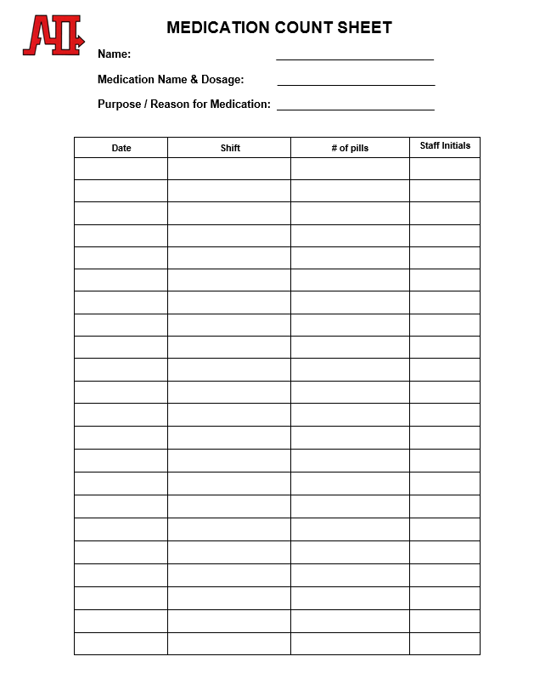

Slide 19
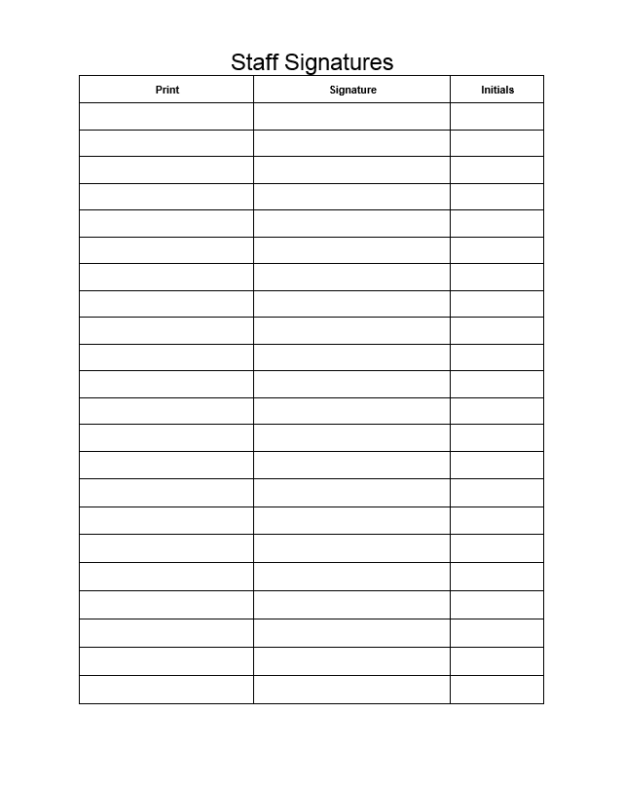

Slide 20
Support Worker Responsibilities:
Review the MAR/med sheet, face sheets, logs, routines upon arrival at a person’s home to ensure you are updated/familiar with the current medical support needs. Complete medication count for any controlled drugs/narcotics if applicable.
Ensure the medication is as prescribed for the condition. Review the Medical/Treatment Profile.
Notes:
Stop here and give out blister pacs.

Slide 23
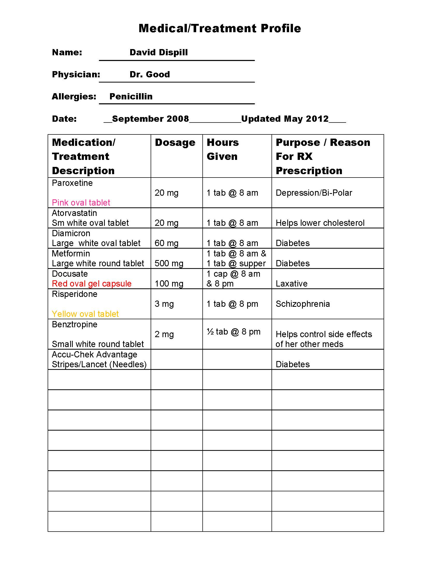

Slide 24
Support Worker Responsibilities:
Review the MAR/med sheet, face sheets, logs, routines upon arrival at a person’s home to ensure you are updated/familiar with the current medical support needs. Complete medication count for any controlled drugs/narcotics if applicable.
Ensure the medication is as prescribed for the condition. Review the Medical/Treatment Profile.
Be knowledgeable of the medication prescribed for the person you are supporting and the possible side effects, particularly when new medication, treatments or PRN has been prescribed.
Ensure the medication is taken on time and as prescribed. Example at 3:00 pm on an empty stomach.
Notes:
Stop here and give out blister pacs.

Slide 25
Support Worker Responsibilities:
Review the MAR/med sheet, face sheets, logs, routines upon arrival at a person’s home to ensure you are updated/familiar with the current medical support needs. Complete medication count for any controlled drugs/narcotics if applicable.
Ensure the medication is as prescribed for the condition. Review the Medical/Treatment Profile.
Be knowledgeable of the medication prescribed for the person you are supporting and the possible side effects, particularly when new medication, treatments or PRN has been prescribed.
Ensure the medication is taken on time and as prescribed. Example at 3:00 pm on an empty stomach.
Be knowledgeable of individual strategies and be mindful of the location where an individual takes their medication.
To complete the necessary documentation medication/treatment sheet, medication/blister pack check list and/or medical information sheet.
To ask questions when you have them.
Notes:
Stop here and give out blister pacs.

Slide 26
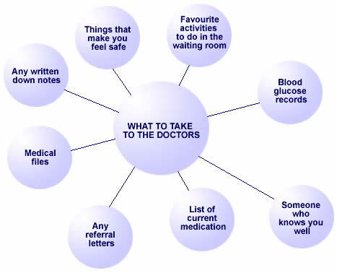
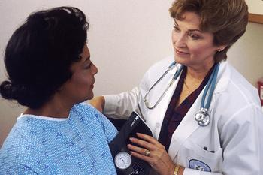
Medical Appointments

Slide 27
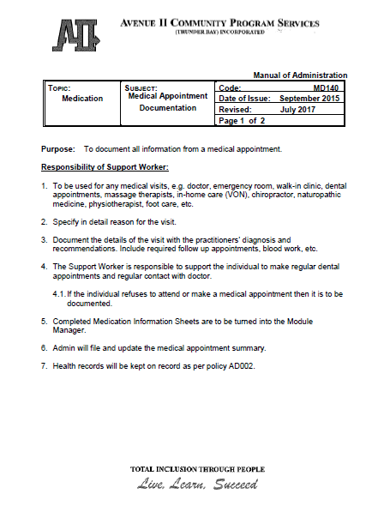

Slide 28
Notes:
28

Slide 29
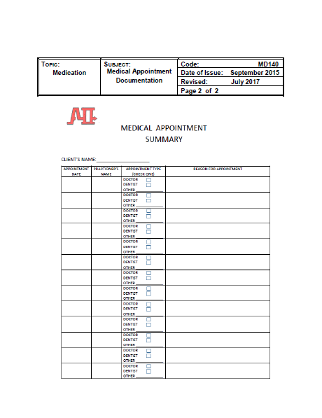

Slide 30
Hand Hygiene
It is good practice and highly recommended to wash your hands prior to and immediately following supporting someone to take their medications.
Gloves should be worn when supporting to apply topical medications or when in direct contact with medications.

Slide 31
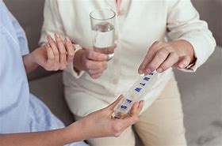
Avenue II Philosophy
Support versus administer

Slide 37
7 - Rights
Right Person
Right Time
Right Drug
Right Route
Right Dosage
Right Documentation
Right Reason

Slide 38
This concludes Part 1 (online portion) of Avenue II’s Medication Awareness Training… Thanks for joining us!
Part two of the training will conducted in person. See you soon!

Slide 39
Receiving Blister Pacs
Ensure the correct name is on blister pac.
Using a Medication/Blister Pac Checklist verify the correct medication prescribed has been received.
Refer to Pharmacy prescription label and Medication/Treatment Profile.
Notes:
Ensure all medication is there and correct.
So nothing is stuck in the blister pack.
Ask and Talk about.

Slide 40
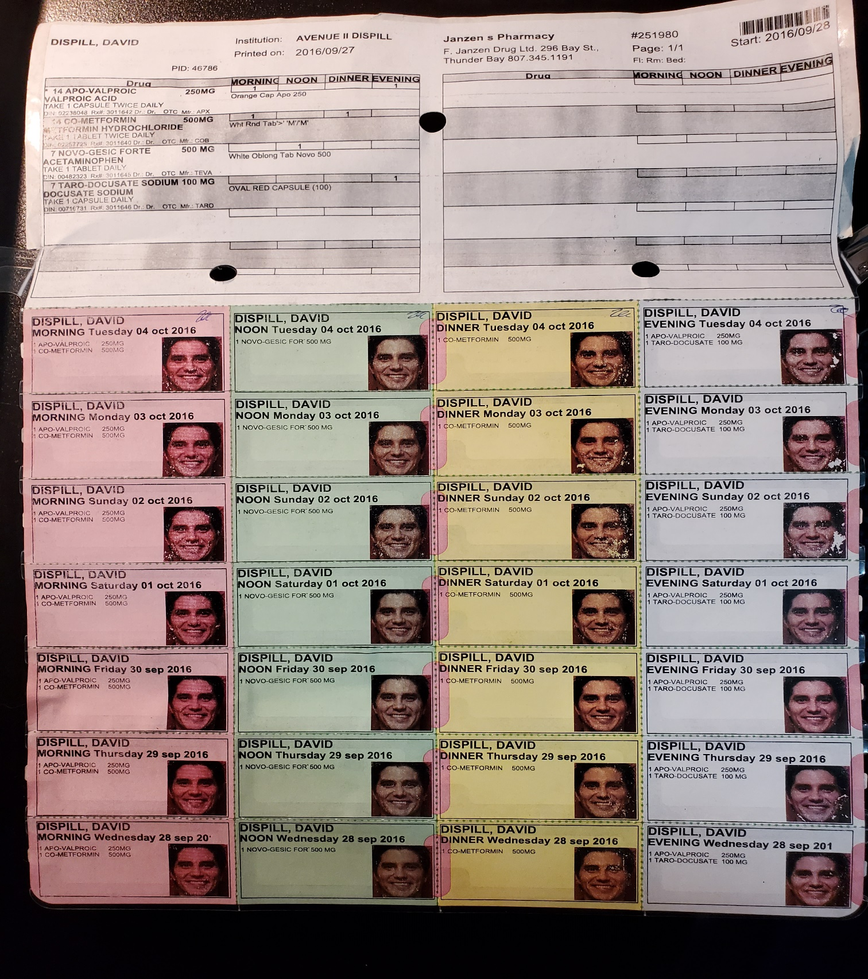

Slide 41
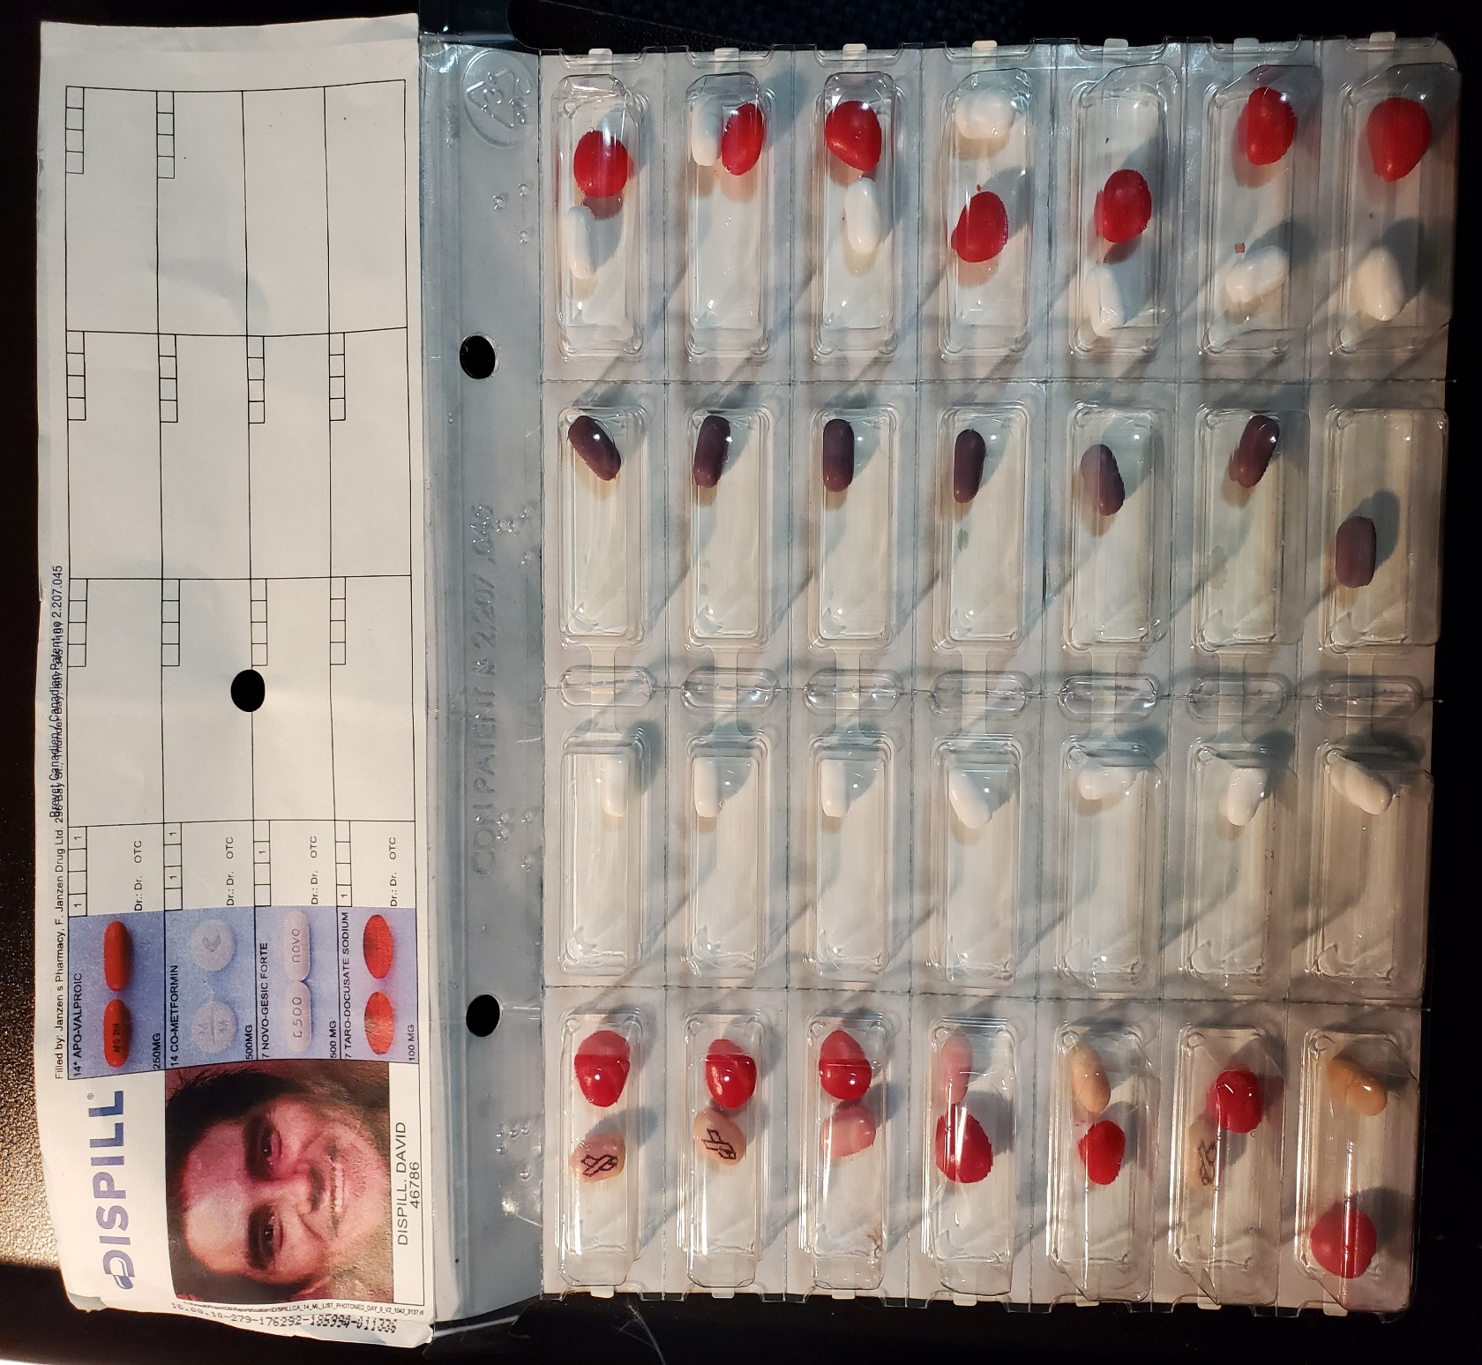

Slide 45
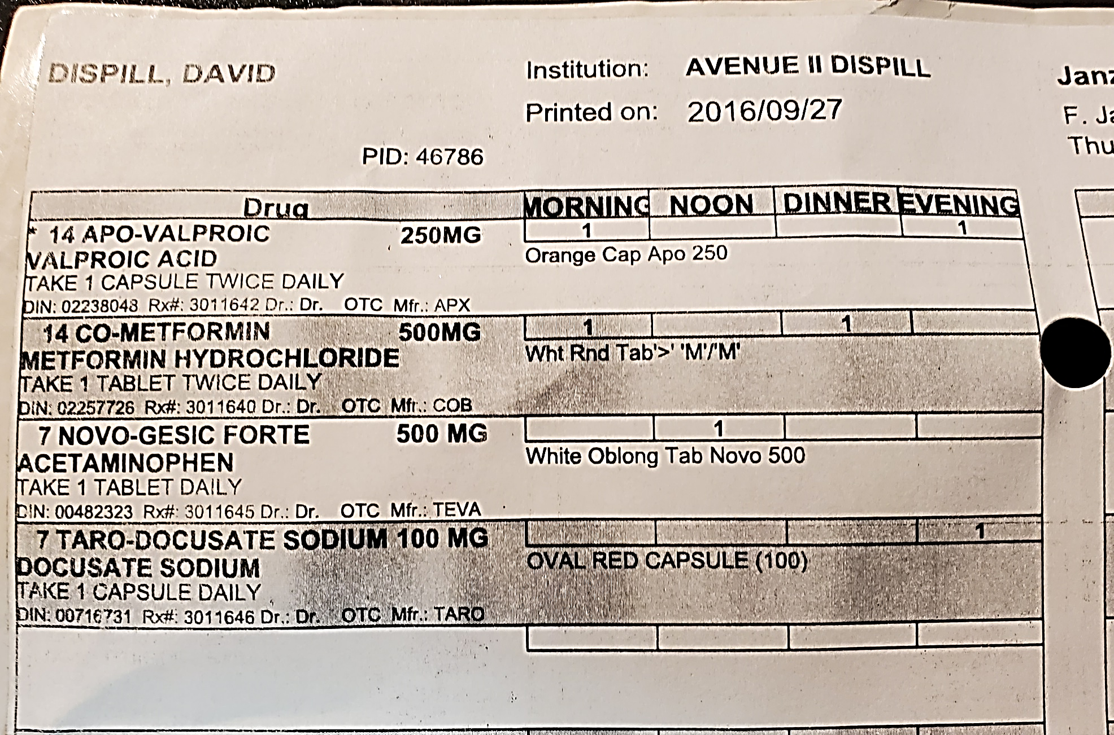

Slide 46
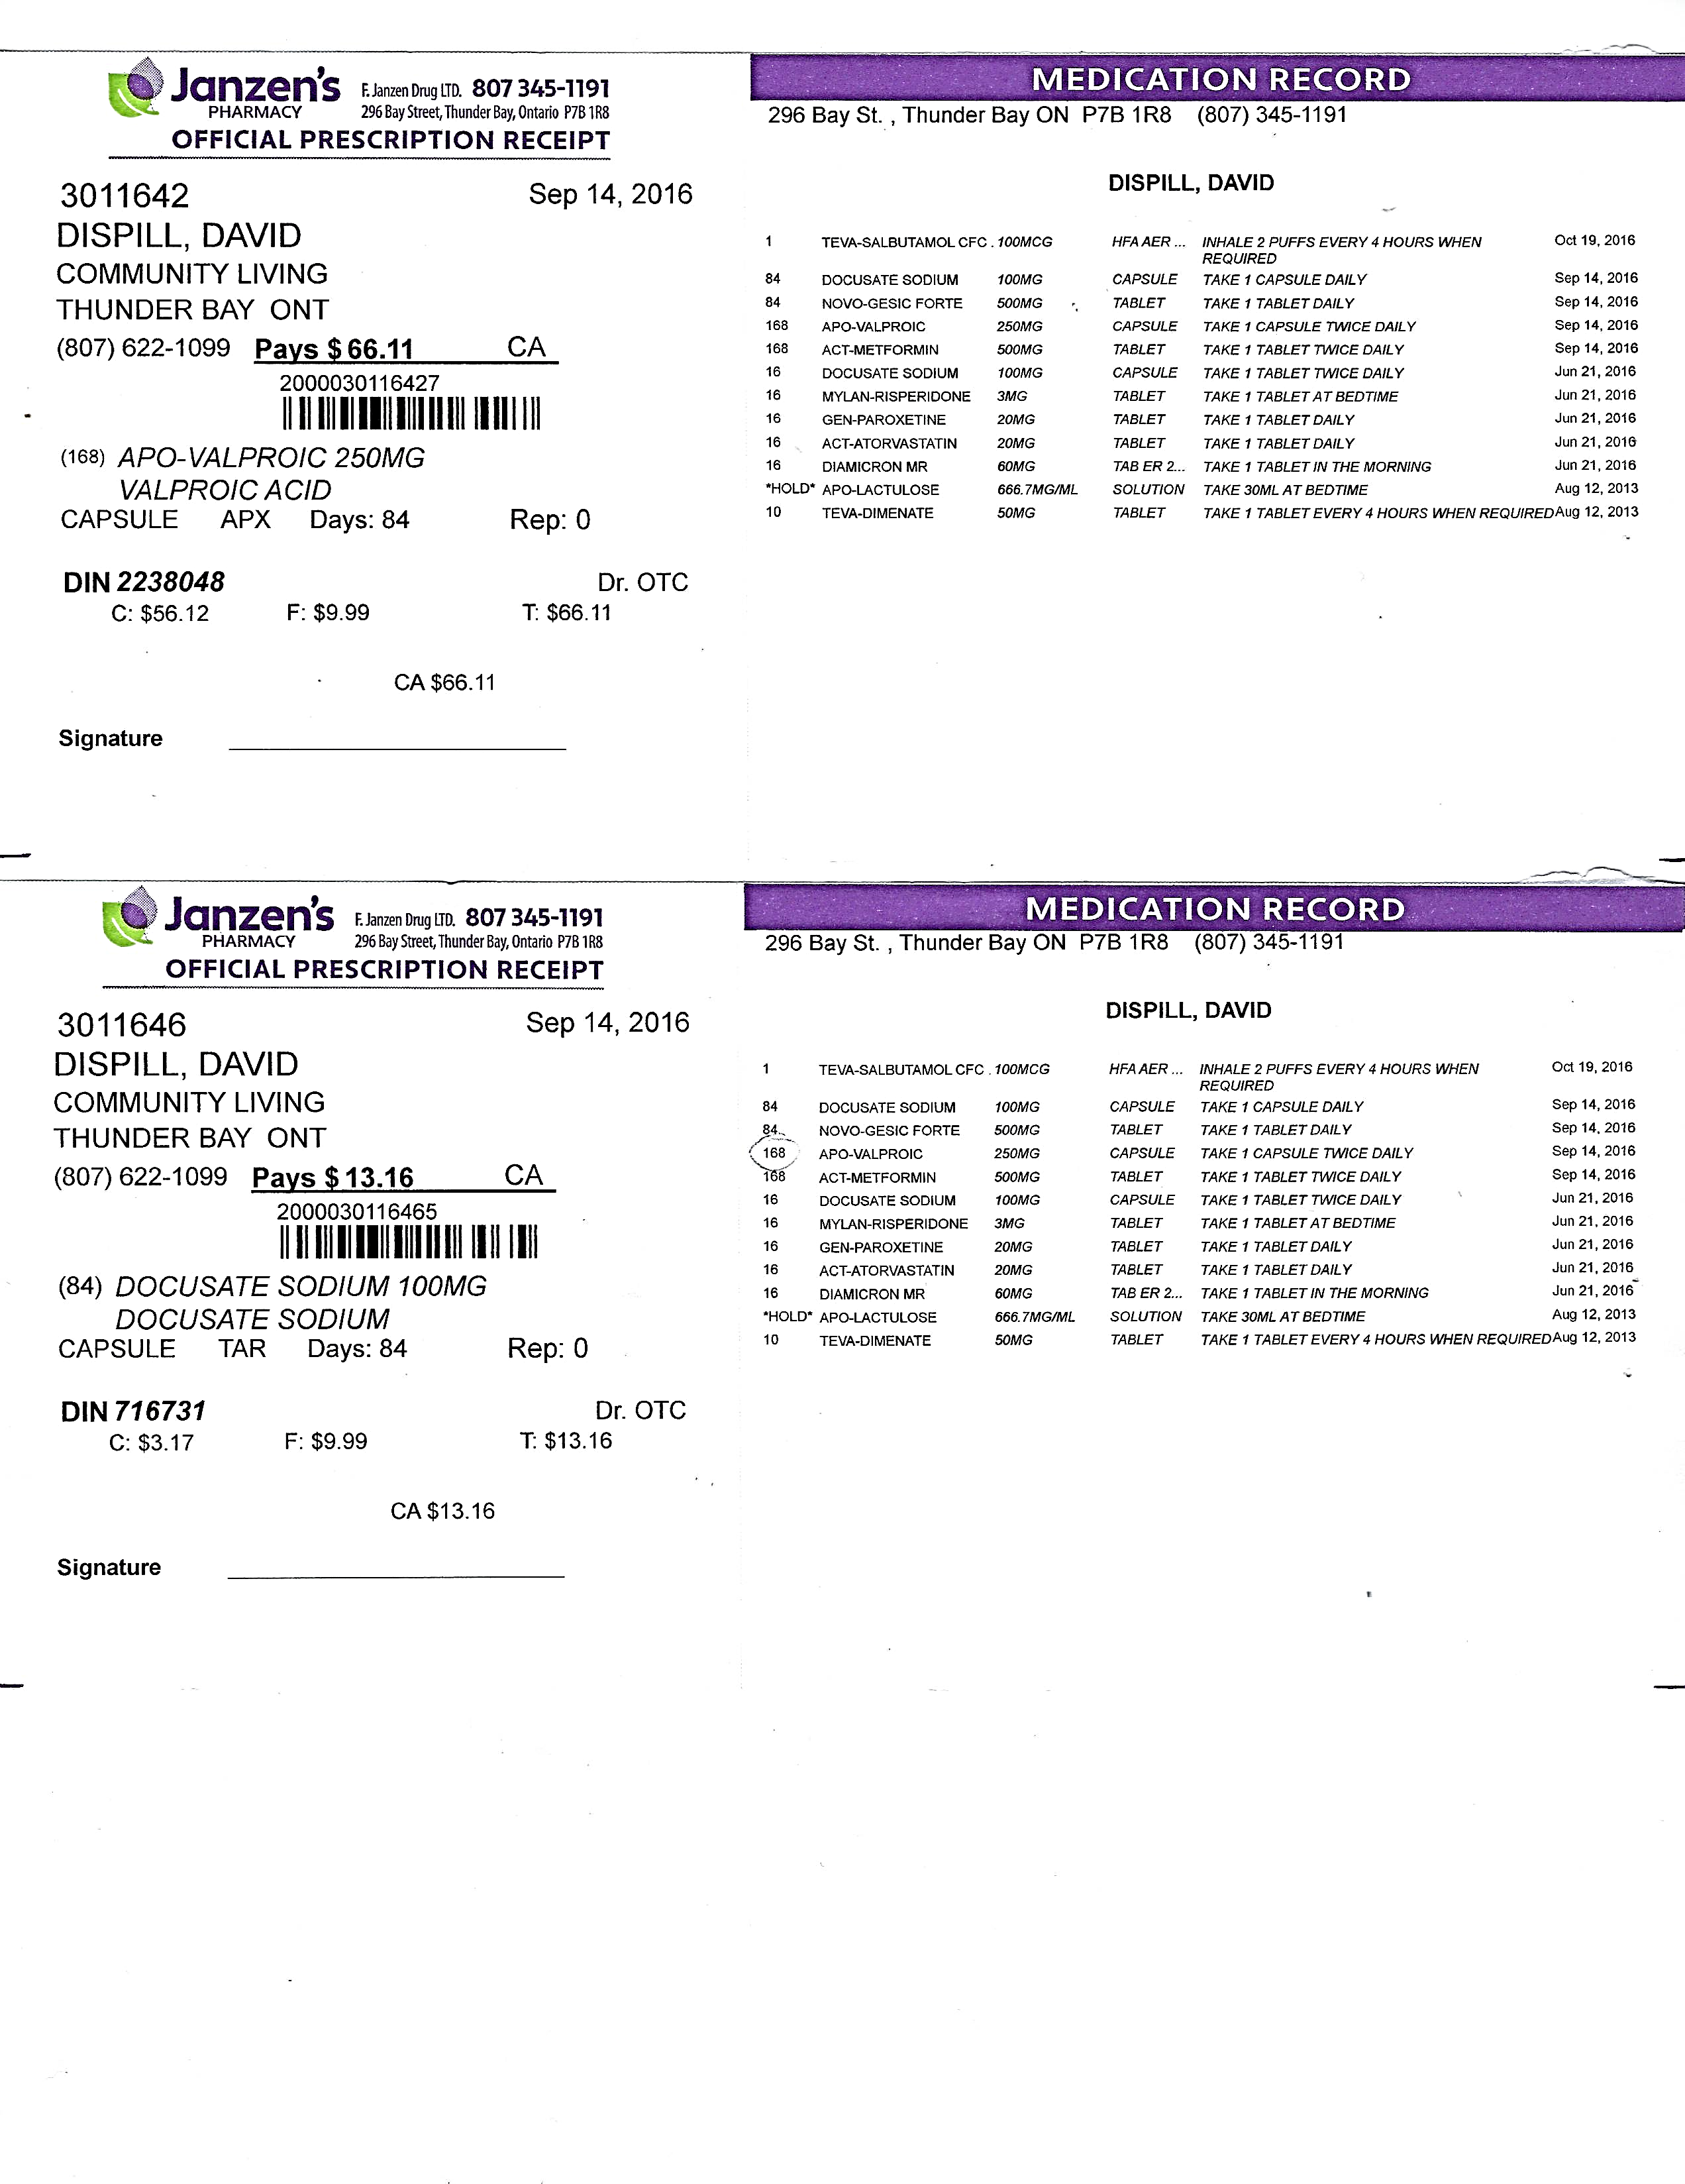

Slide 47
Blister Pac/Treatment Checklist
Completed upon receipt of any medication or blister pac(s)/treatment Name:______________________
 |  |  | Instructions
Date of Delivery | Medication Name and Description | Medication Dosage | Morning | Noon | Supper | Bedtime | Quantity | Repeats | Staff Inital
04/11/16 | Dilantin – colour/shape/capsule/tablet | 100mg | 2 |  |  | 3 | 28 | 1 | S.C.
04/11/16 | Tylenol #3 – colour/shape/capsule/tablet |  |  | PRN every 8 hrs for pain |  |  | 30 | 0 | S.C.
04/11/16 | Paxoxetine – pink oval tablet | 20 mg | 1 |  |  |  | 7 | 0 | D.G.
04/11/16 | Atrovastatin – small white oval tablet | 20 mg | 1 |  |  |  | 7 | 0 | D.G.
04/11/16 | Diamicron – large white oval tablet | 60 mg | 1 |  |  |  | 7 | 0 | D.G.
04/11/16 | Metformin – large white round tablet | 500 mg | 1 |  | 1 |  | 14 | 0 | D.G.
04/11/16 | Docusate – red oval gel capsule | 100 mg | 1 |  |  |  | 14 | 0 | D.G.
04/11/16 | Risperidone – yellow oval tablet | 3 mg |  |  |  | 1 | 7 | 0 | D.G.
04/11/16 | Benztropine – small white round tablet | 2 mg | ½ |  |  | ½ | 5.5 | 0 | D.G.
 |  |  | Instructions
Date of Delivery | Medication Name and Description | Medication Dosage | Morning | Noon | Supper | Bedtime | Quantity | Repeats | Staff Inital
04/11/16 | Dilantin – colour/shape/capsule/tablet | 100mg | 2 |  |  | 3 | 28 | 1 | S.C.
04/11/16 | Tylenol #3 – colour/shape/capsule/tablet |  |  | PRN every 8 hrs for pain |  |  | 30 | 0 | S.C.
04/11/16 | Paxoxetine – pink oval tablet | 20 mg | 1 |  |  |  | 7 | 0 | D.G.
04/11/16 | Atrovastatin – small white oval tablet | 20 mg | 1 |  |  |  | 7 | 0 | D.G.
04/11/16 | Diamicron – large white oval tablet | 60 mg | 1 |  |  |  | 7 | 0 | D.G.
04/11/16 | Metformin – large white round tablet | 500 mg | 1 |  | 1 |  | 14 | 0 | D.G.
04/11/16 | Docusate – red oval gel capsule | 100 mg | 1 |  |  |  | 14 | 0 | D.G.
04/11/16 | Risperidone – yellow oval tablet | 3 mg |  |  |  | 1 | 7 | 0 | D.G.
04/11/16 | Benztropine – small white round tablet | 2 mg | ½ |  |  | ½ | 5.5 | 0 | D.G.

Slide 48
Receiving Blister Pacs
Ensure the correct name is on blister pac.
Using a Medication/Blister Pac Checklist verify the correct medication prescribed has been received.
Refer to Pharmacy prescription label and Medication/Treatment Profile.
If needed complete Medication/Treatment Sheet.
Notes:
Ensure all medication is there and correct.
So nothing is stuck in the blister pack.
Ask and Talk about.

Slide 51
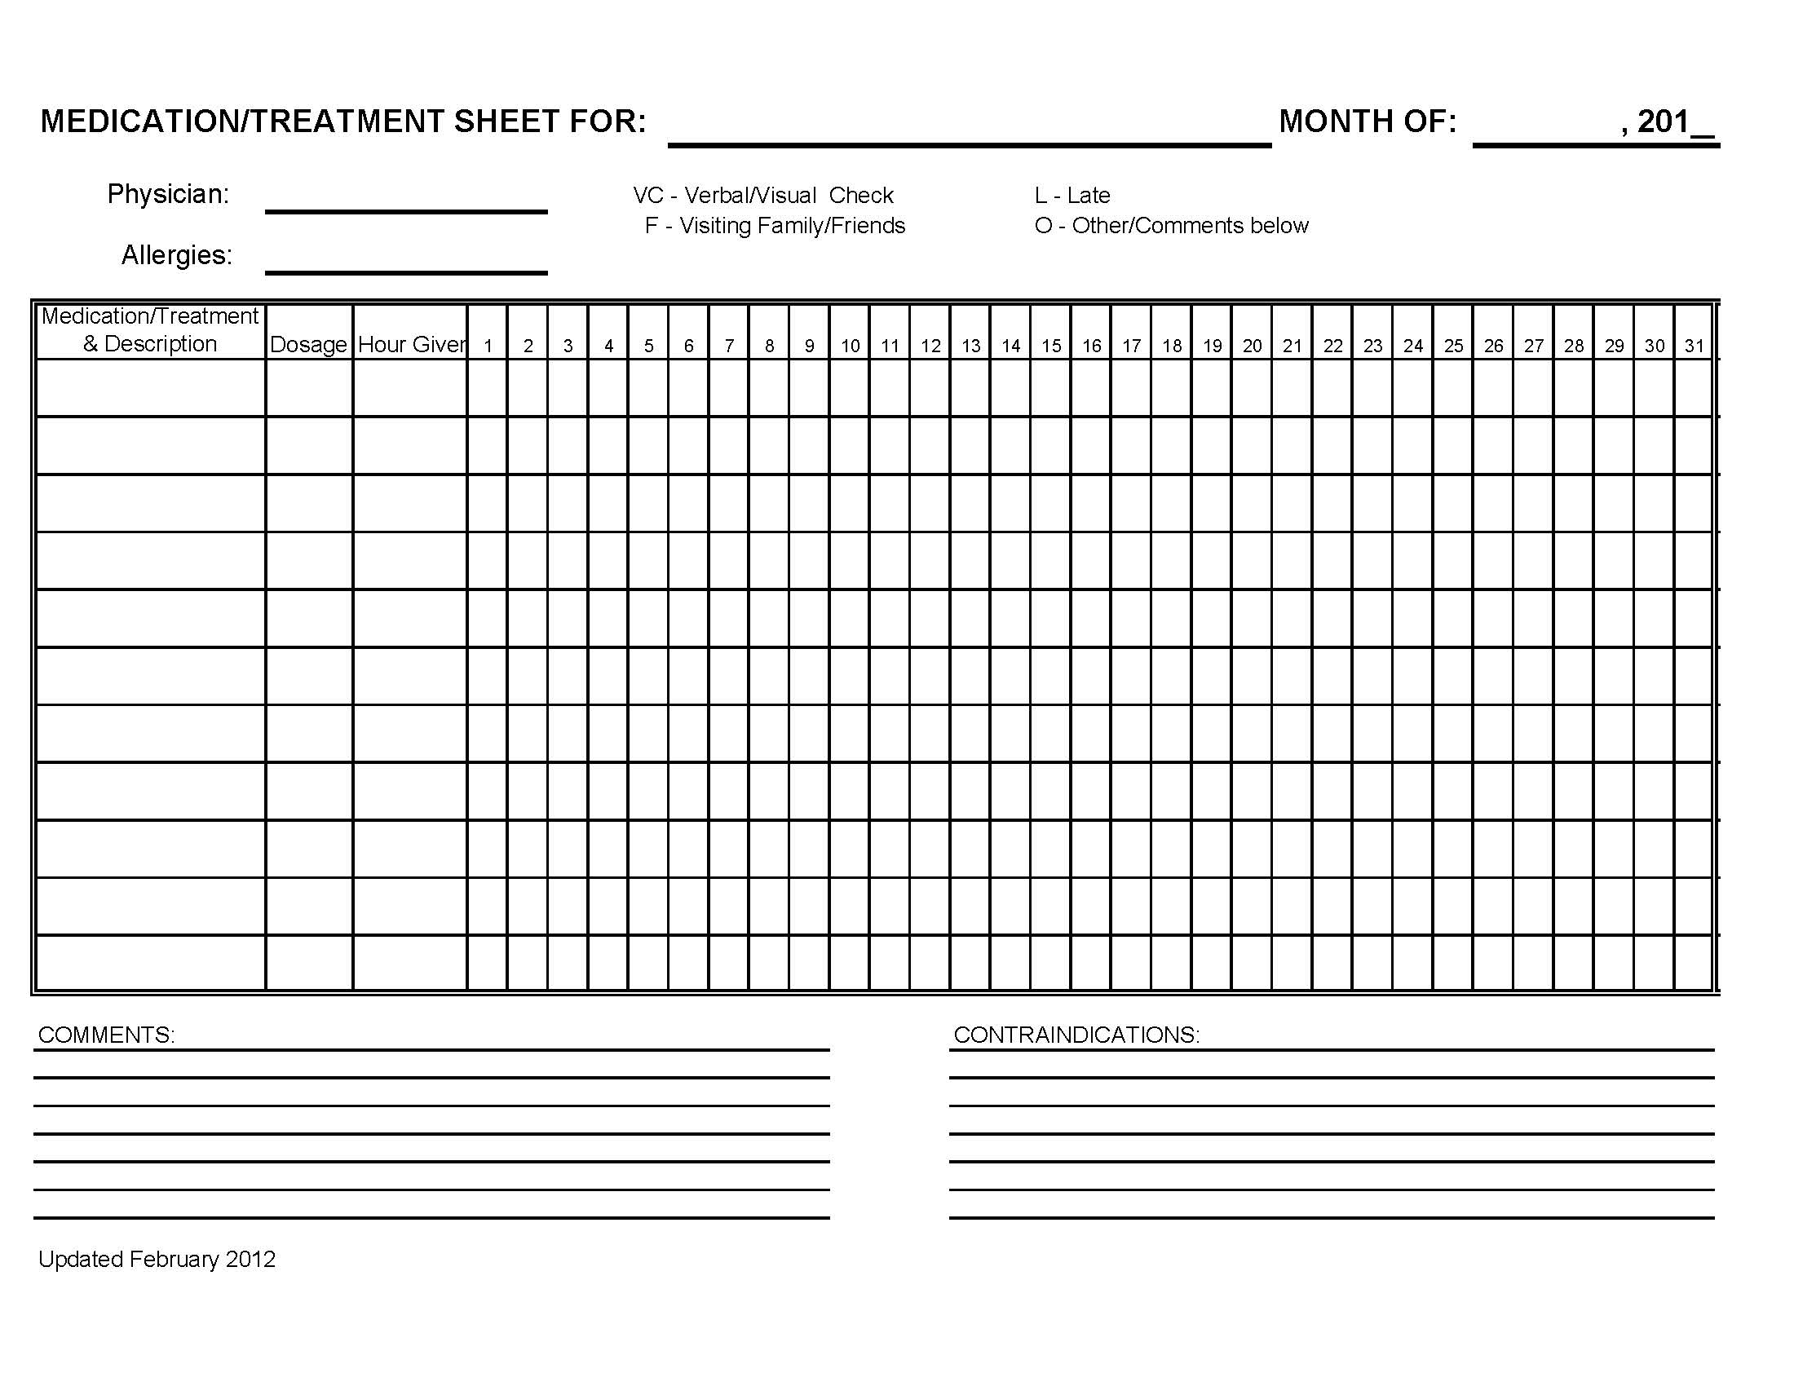

Slide 53
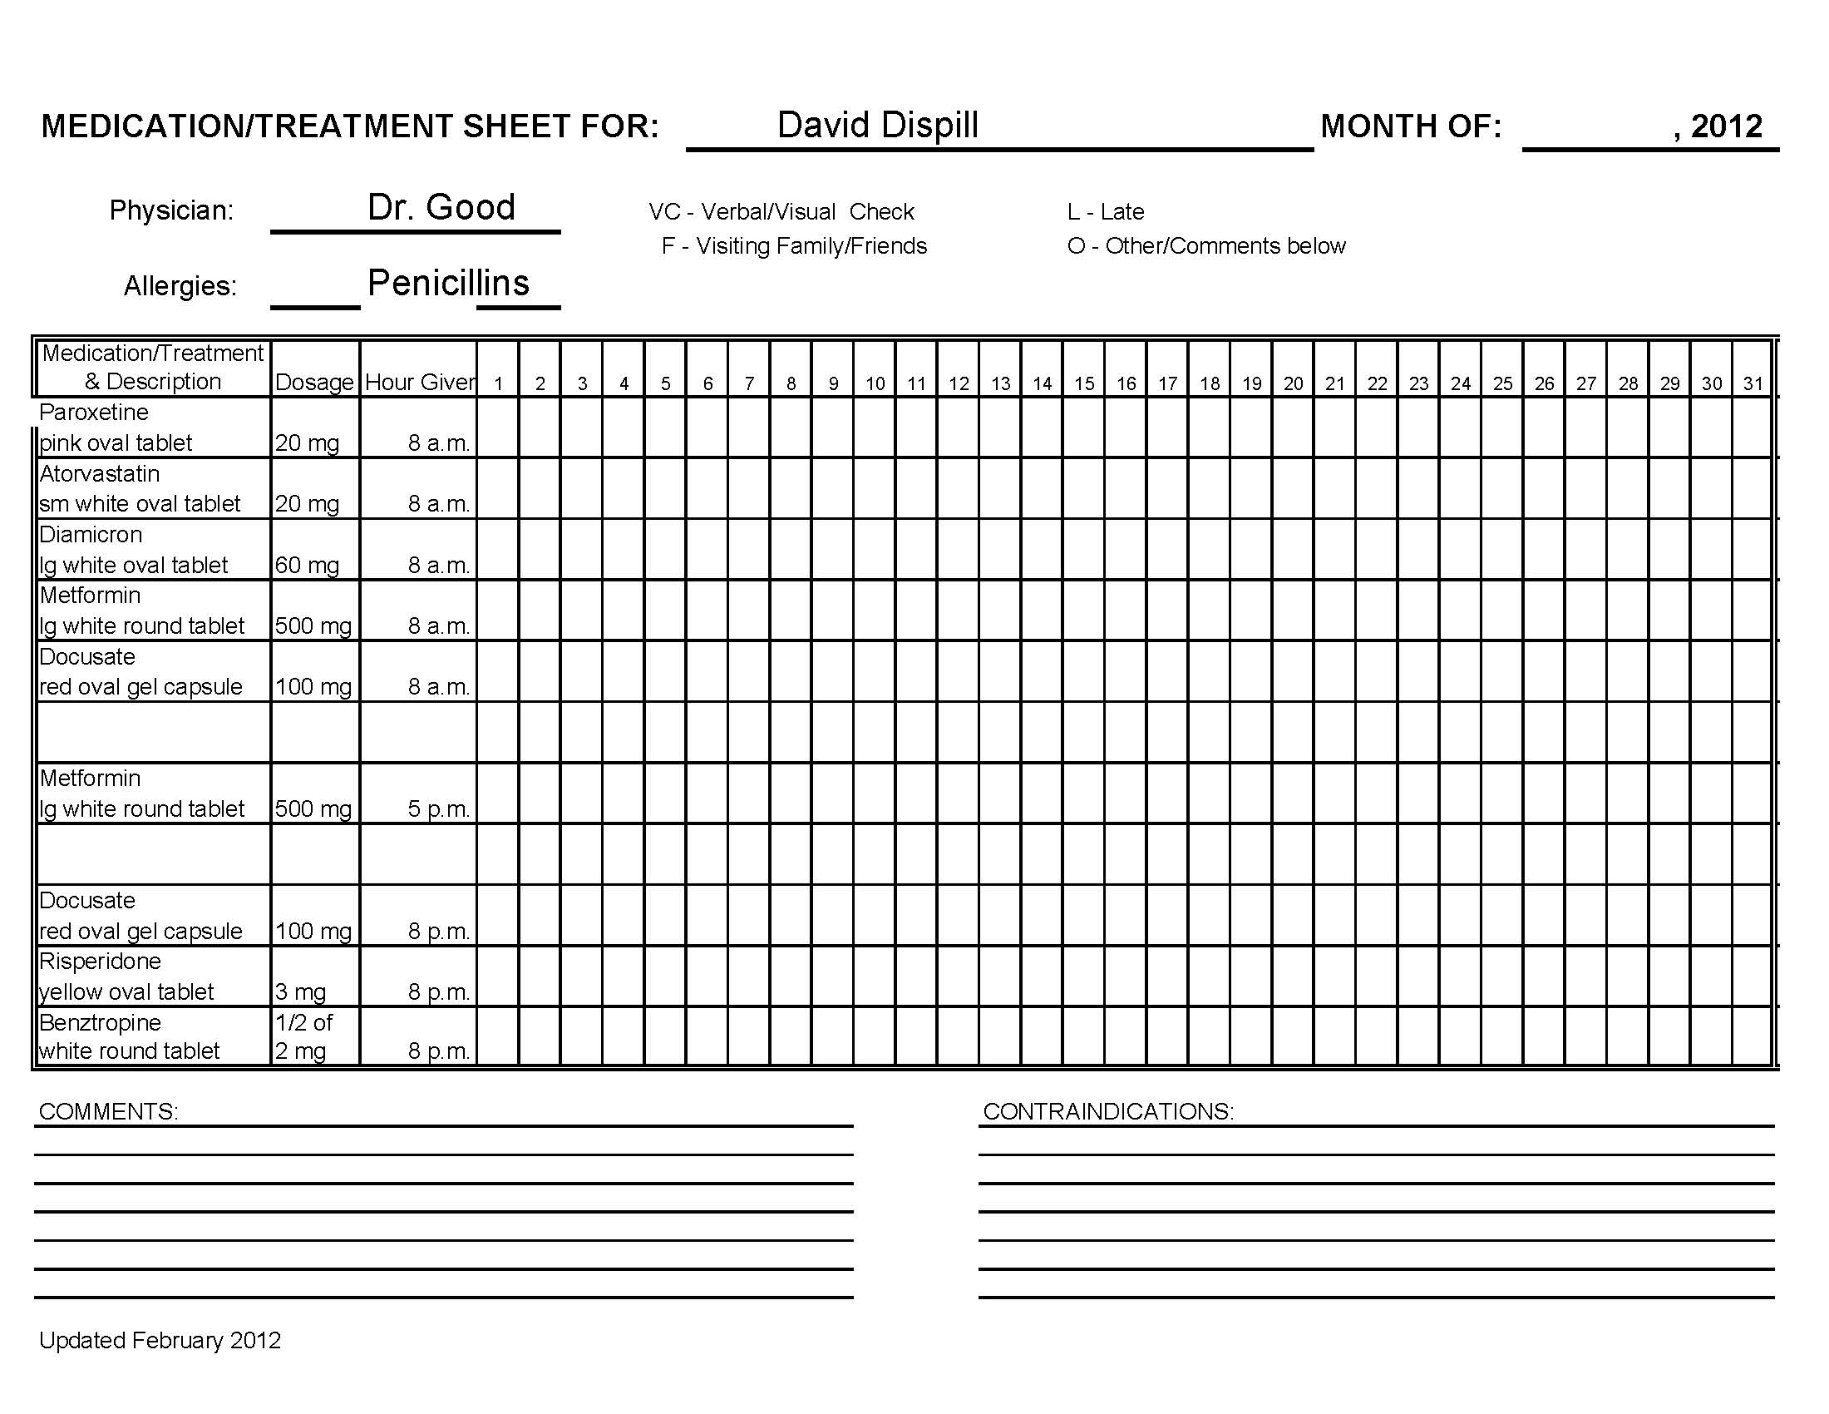

Slide 54
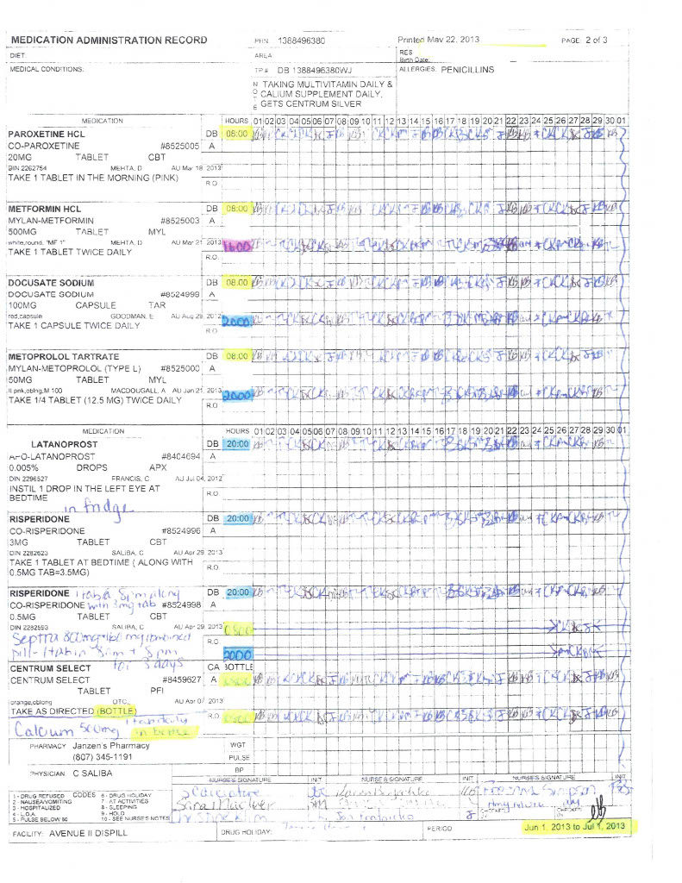

Slide 55
Receiving Blister Pacs
Ensure the correct name is on blister pac.
Using a Medication/Blister Pac Checklist verify the correct medication prescribed has been received.
Refer to Pharmacy prescription card and Medication/Treatment Profile.
If needed complete Medication/Treatment Sheet.
Once completed ensure medication is stored in designated location.
Notes:
Ensure all medication is there and correct.
So nothing is stuck in the blister pack.
Ask and Talk about.

Slide 57
Did You?
Ensure the correct name is on blister pac/ Treatment.
Verify the correct medication prescribed is in the blister pac.
Visually verifying each time supporting.
Eg. Counting pills before entering mouth.
Ensure the individual has ingested medication.
Ensure you have signed for medication.
Ensure medication if needed is reordered prior to the end of the supply.
Notes:
Ensure all medication is there and correct.
So nothing is stuck in the blister pack.
Ask and Talk about.

Slide 58
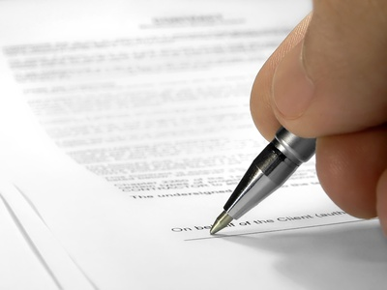
Signing
Sign / Initial medications sheets IMMEDIATELY AFTER person has been supported to take medication.
NEVER Sign in Advance
Notes:
You could be:
- Called out – gone home sick
- Person refused

